Slide 1
Overview
The first step of the point selection process is to pull relevant contracts and email them to David Tilson for prioritization. The following slides have been prepared by Jacob Comer showing how to do the data pulls.
For details about the entire point selection process, see pg. 1-2 of the Point Count SOP.

Slide 2
Pulling all EQIP Contracts
Instructions for how to pull contracts for NOBO monitoring study
Please follow these instructions carefully to pull the needed information
Data pull #1 instructions: Pulling all EQIP contracts
Data Pull #2 Instructions: Pulling all EQIP WLFW contracts
Please read the entirety of instructions for both data pulls

Slide 3
Data Pull #1
All EQIP Contracts

Slide 4
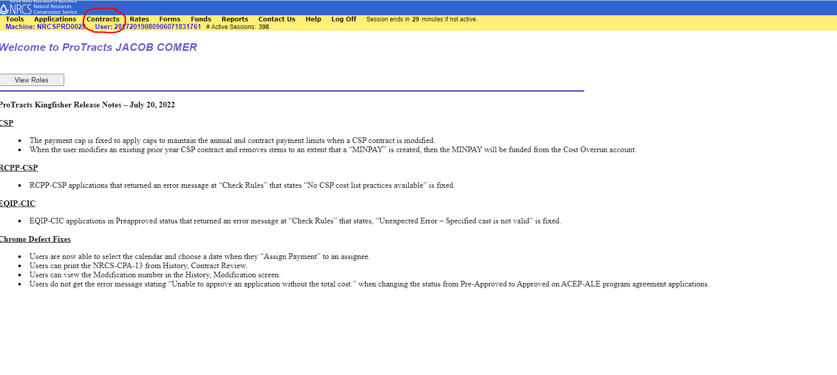
Step 1: Open protracts and select contracts at the top of the screen

Slide 5
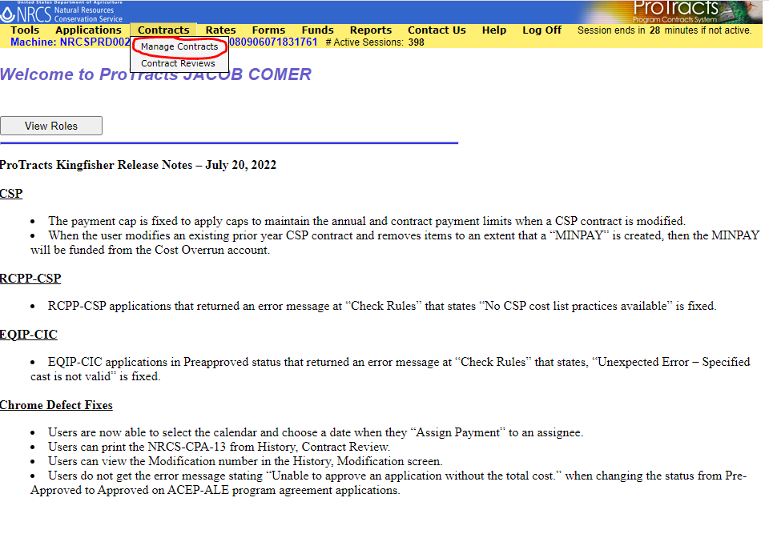
Step 2: From the drop down, select “Manage Contracts”

Slide 6
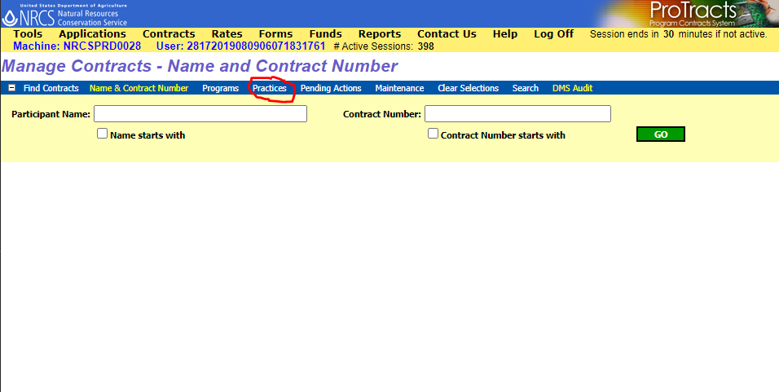
Step 3: In the blue toolbar that appears after selecting “manage contracts” select “Practices”

Slide 7
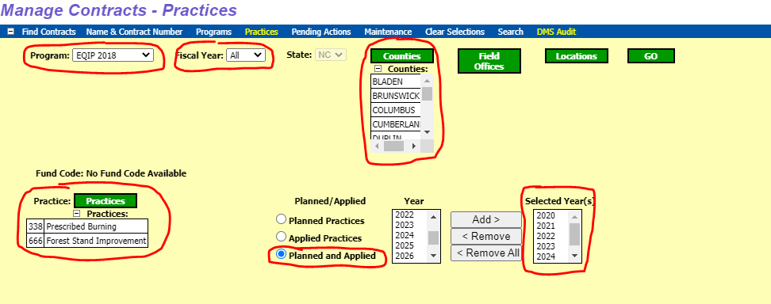
Step 4
-Program: Select EQIP 2018
-Fiscal year: All
-Counties: Select all or the counties you cover
-Practices: Click Practices and select those associated with your state (refer to slides 10-12 in the WLFW_Monitoring_Design.pptx)
-Select “Planned and Applied”
-Add the years 2021 through 2027 (This accounts for 3 FY prior to FY 24 and 3 after)
-Click Go

Slide 8
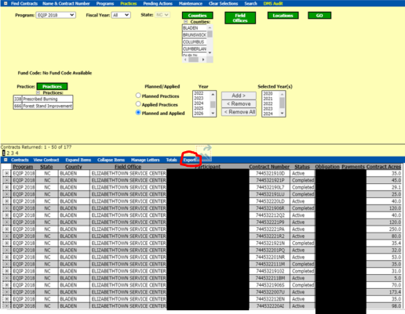
Step 5: From the table the comes up click Export

Slide 9
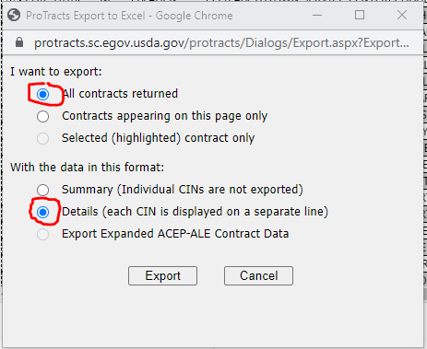
Step 6: Select All contracts returned and Details

Slide 10
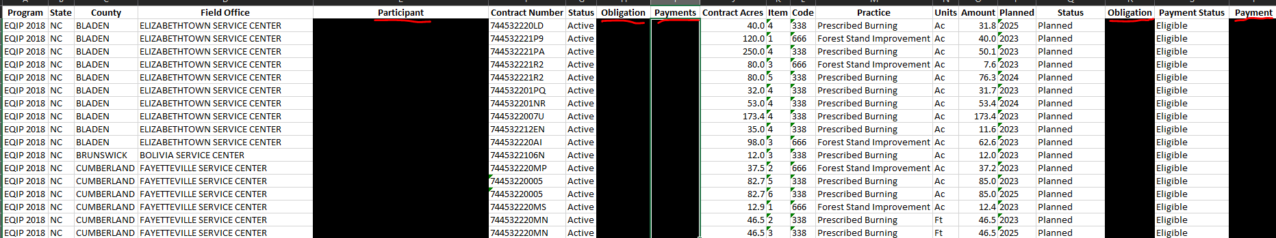
Step 7: DELETE participant name, obligation amount, payments, obligation, and payment columns
Do not only black out the columns delete them from the file

Slide 11
Step 8: Save Excel as seen above but for respective state.
(i.e 338_666_Completed_Planned_EQIP_South_Carolina)

Slide 12
Data Pull #2
WLFW Contracts
Follow steps 1-3 from Data Pull #1 instructions

Slide 13
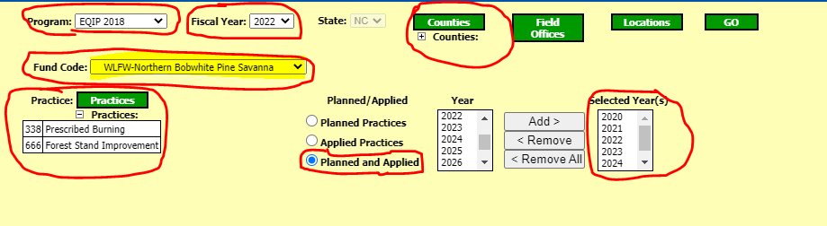
Step 4:
-Program: Select EQIP 2018
-Fiscal Year: Select 2022
-Counties: Select all or the counties you cover
-Fund Code: WLFW-Northern Bobwhite Pine Savanna
-Practices: Click Practices and select those associated with your state (refer to slides 10-12 in the WLFW_Monitoring_Design.pptx)
-Select “Planned and Applied”
-Add the years 2021 through 2027 (This accounts for 3 FY prior to FY 24 and 3 Fy after)
-Click Go

Slide 14
Continue to follow steps 5-7 from data pull #1 instructions
Note: This is not the final step in data pull #2

Slide 15
Step 6: Select All contracts returned and Details

Slide 16
Step 7: DELETE participant name, obligation amount, payments, obligation, and payment columns
Do not only black out the columns delete them from the file

Slide 17
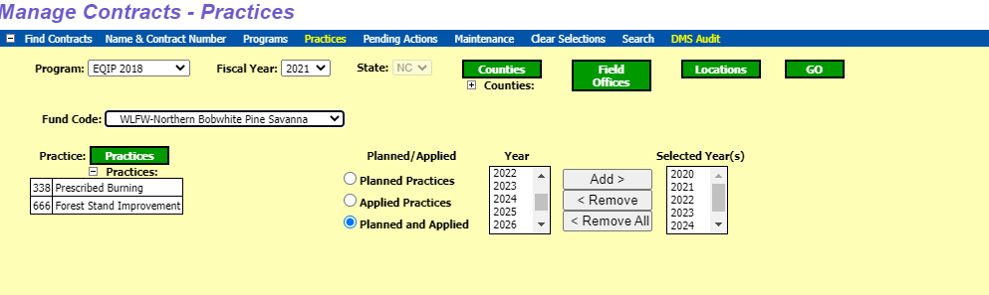
Step 8: Repeat step 4-6 again for each FY through FY 2021.
This will create a table for each FY
2023
2022
2021

Slide 18
Step 9: Combine each table from FY 23’, 22’, and 21’ into one table
Step 10: Save Excel as seen above
(i.e 338_666_WLFW_Completed_Planned_EQIP_South_Carolina)

Slide 19
Final Step for both Data Pulls
Email the spreadsheet to David Tilson (david.tilson@uga.edu).

